Slide 1
Classify gestures by reading muscle activity Iman Fekri and Mohammad Hossein Bayati

Slide 2
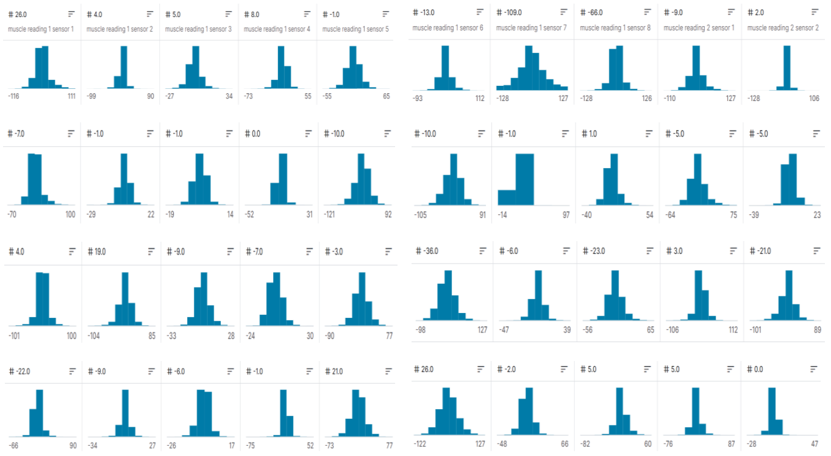
Data collected from the robot arm

Slide 3
Smart methods are used to check accuracy
recurrent neural network (RNN)
Support Vector Machine (SVM)
Random forest (RF)
Support Vector Classification (SVC)
Decision Tree
Multilayer perceptron (MLP)
Nearest neighbor (NN)

Slide 4
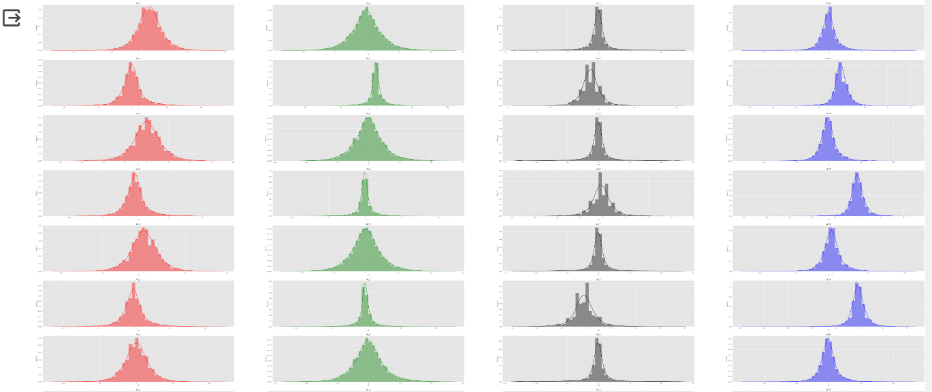
Data preprocessing methods
1) Data distribution
2) Data standardization
3) Shuffle data

Slide 5
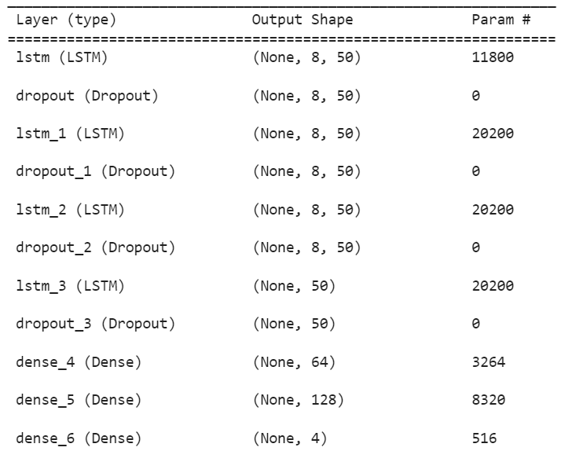
recurrent neural network (RNN)
model = Sequential()
model.add(LSTM(units=50, return_sequences=True, input_shape=(X_train.shape[1], 8)))
model.add(Dropout(0.2)) #dropout rate = 20%
model.add(LSTM(units = 50, return_sequences = True))
model.add(Dropout(0.2))
model.add(LSTM(units = 50, return_sequences = True))
model.add(Dropout(0.2))
model.add(LSTM(units = 50))
model.add(Dropout(0.2))
model.add(Dense(units = 64))
model.add(Dense(units = 128))
model.add(Dense(units = 4, activation="softmax")) #4 as the output classes
model.compile(optimizer = "adam" , loss = "categorical_crossentropy", metrics=["accuracy"])

Slide 6
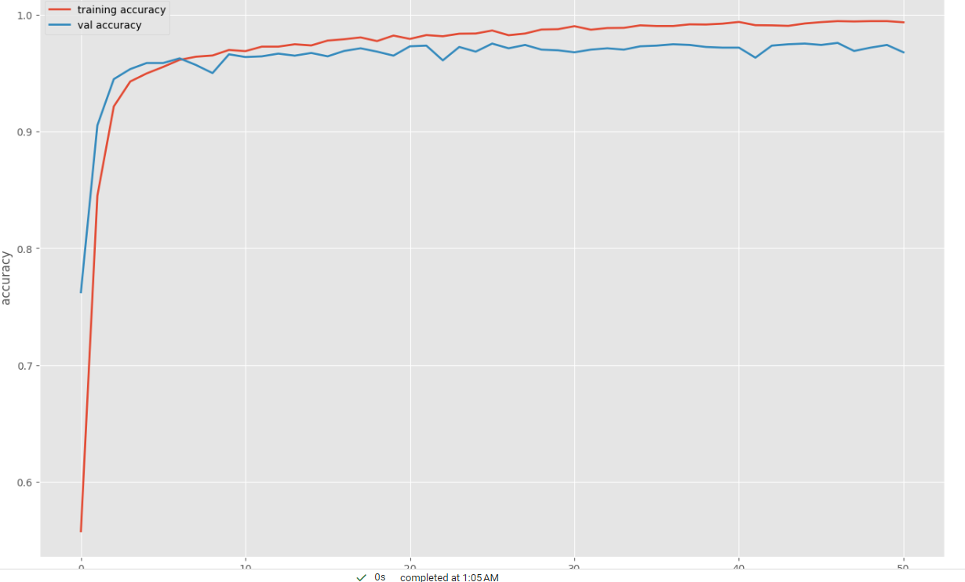
Display accuracy and loss graph

Slide 7
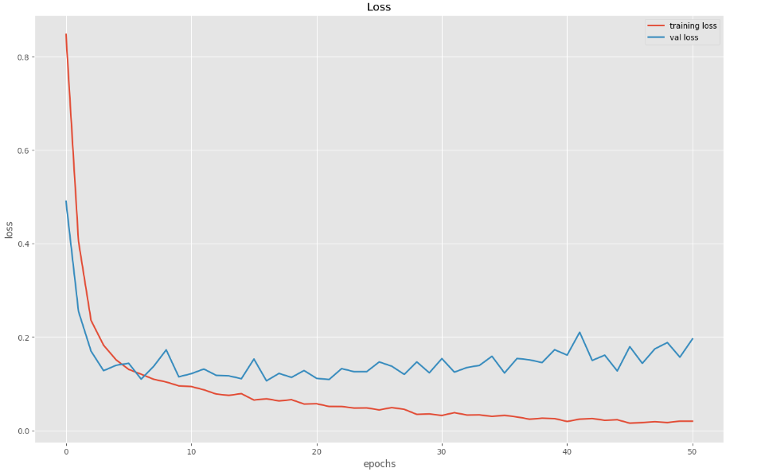
Display accuracy and loss graph

Slide 8
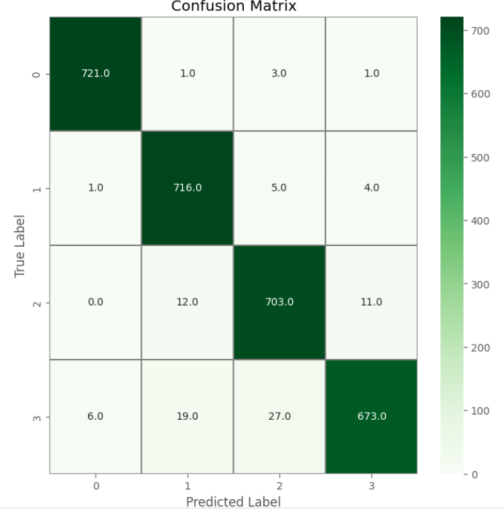
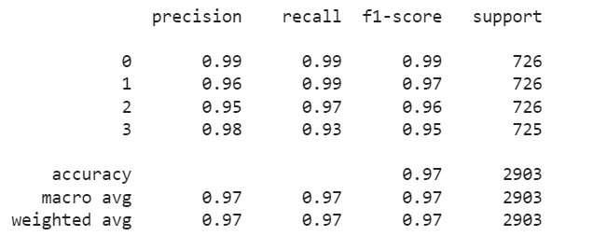
Show the confusion matrix and the final results

Slide 9

classifier = TimeSeriesSVC(kernel='linear',random_state = 93)
classifier.fit(X_train_svm,y_train_svm)
y_pred_svm_1 = classifier.predict(X_test_svm)
classifier = TimeSeriesSVC(kernel='rbf',random_state = 93)
classifier.fit(X_train_svm,y_train_svm)
y_pred_svm_2 = classifier.predict(X_test_svm)
classifier = TimeSeriesSVC(kernel='poly',random_state = 93)
classifier.fit(X_train_svm,y_train_svm)
y_pred_svm_3 = classifier.predict(X_test_svm)
classifier = TimeSeriesSVC(kernel='sigmoid',random_state = 93)
classifier.fit(X_train_svm,y_train_svm)
y_pred_svm_4 = classifier.predict(X_test_svm)

Slide 10
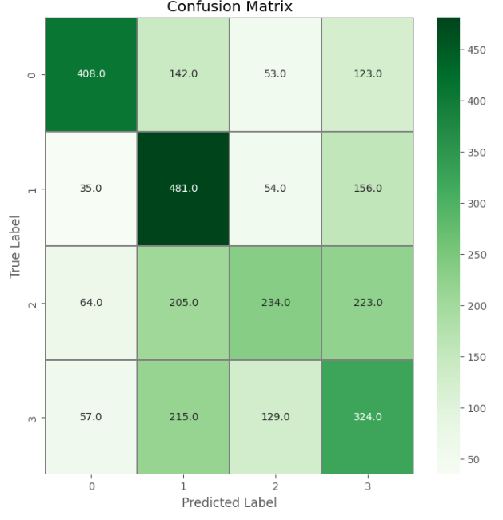
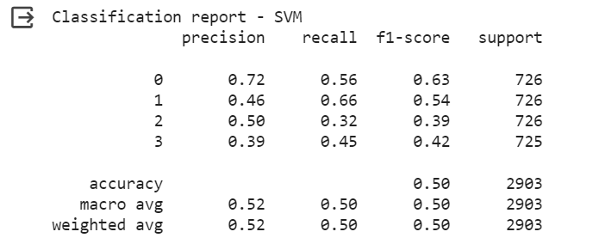
Show the confusion matrix and the final results

Slide 11

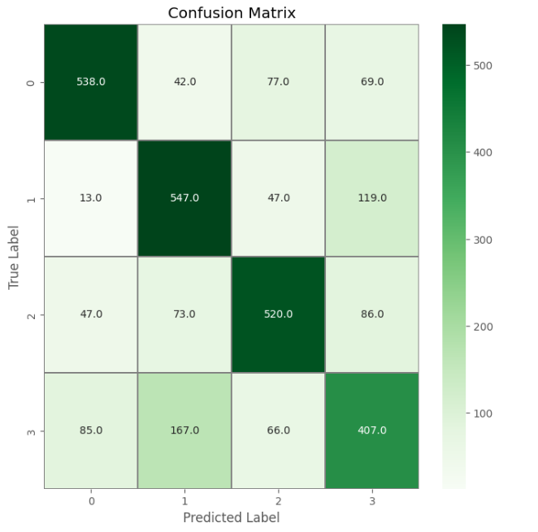
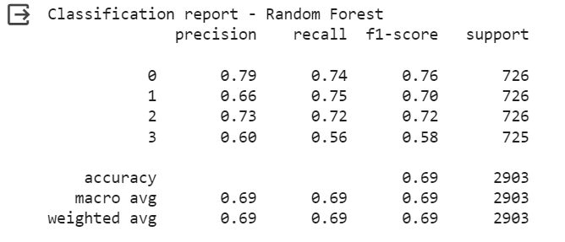
#fit of the classifier to the training data rf_model = RandomForestClassifier(n_estimators=100,random_state=93) rf_model.fit(X_train_rf, y_train_rf)

Slide 12

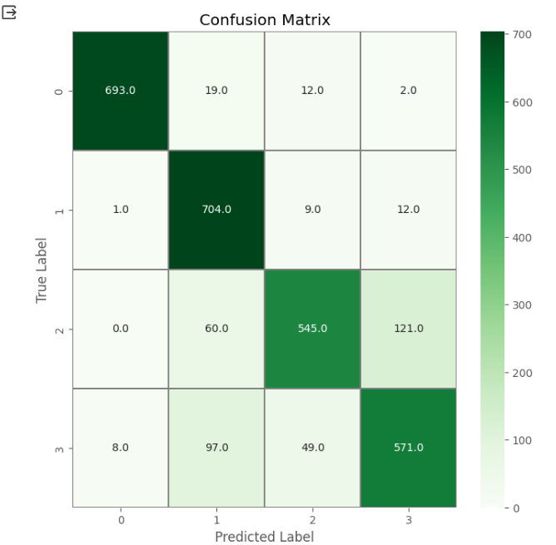
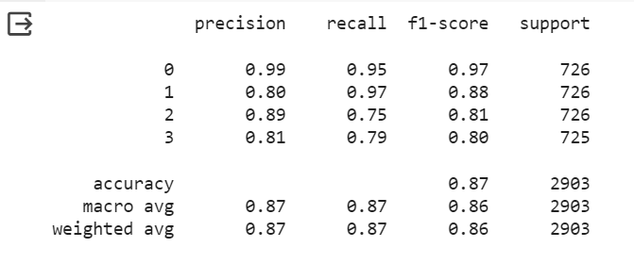
model = SVC(kernel = 'rbf',decision_function_shape='ovo') model.fit(X_train, y_train(

Slide 13
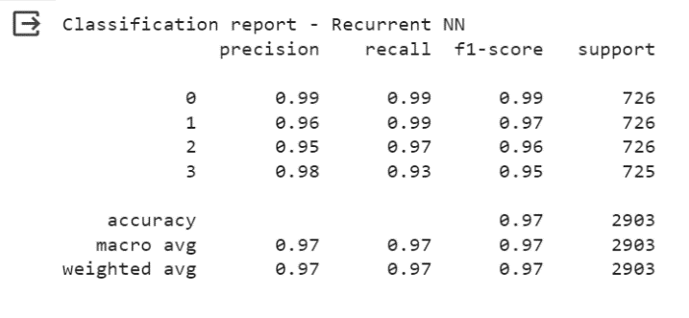
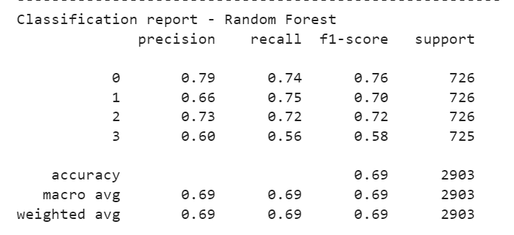
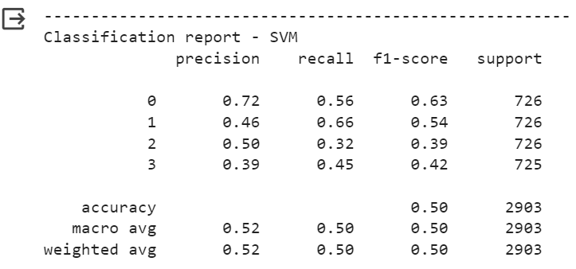
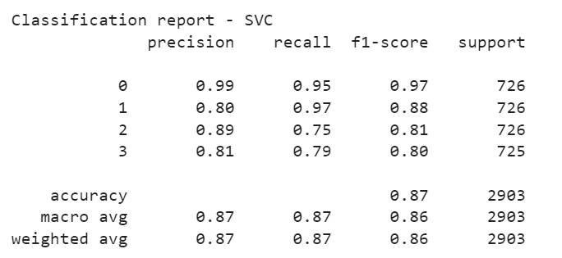
Comparison of four methods at a glance

Slide 14
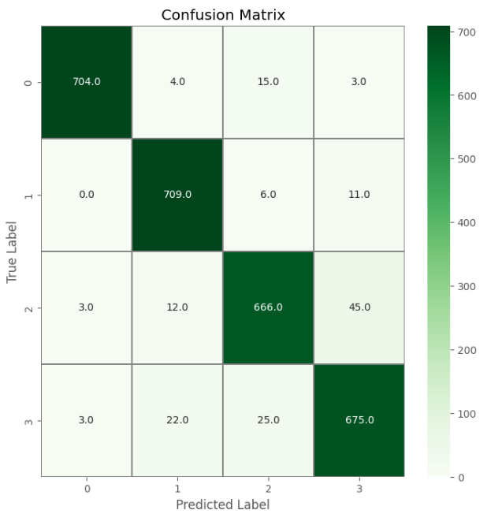

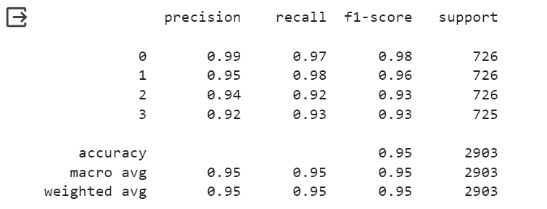
model = MLPClassifier(hidden_layer_sizes=(80,), activation='relu', solver='adam',
alpha=0.1,max_iter=100, shuffle=True, random_state=93)
model.fit(X_train, y_train)
model.score(X_test, y_test)

Slide 15


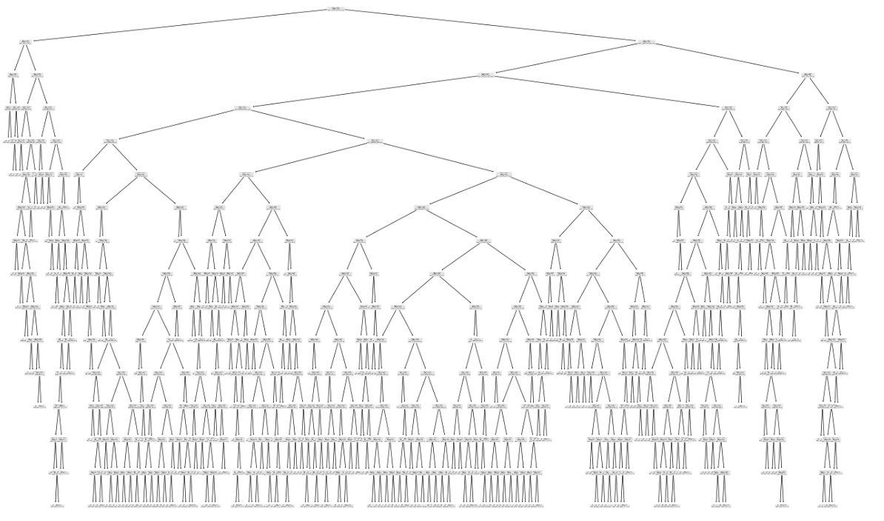
clf = tree.DecisionTreeClassifier(max_depth=18, random_state=42, ccp_alpha=0.001)
clf.fit(X_train, y_train)

Slide 16
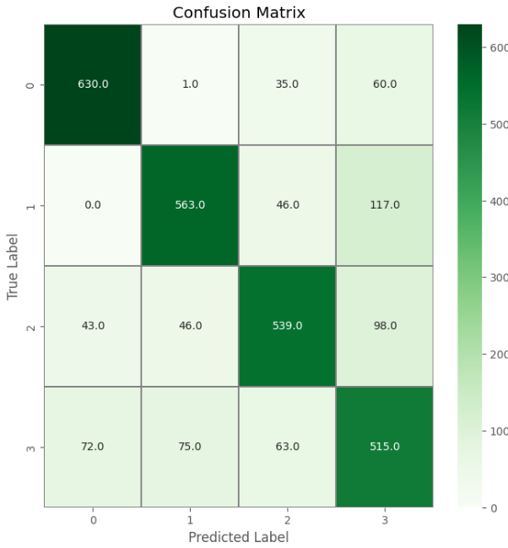
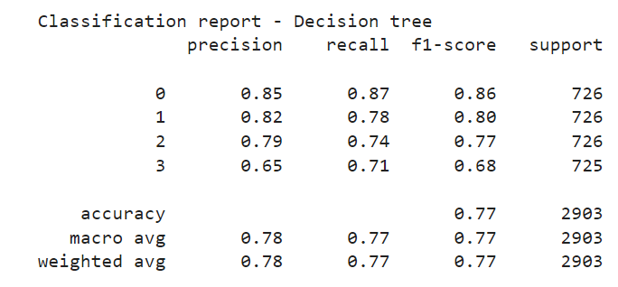
Show the confusion matrix and the final results

Slide 17

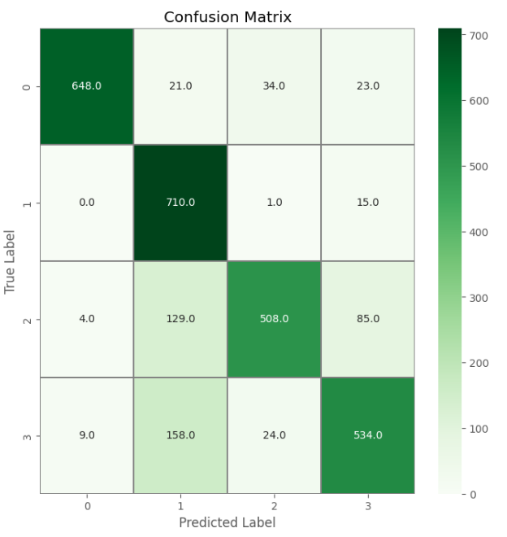
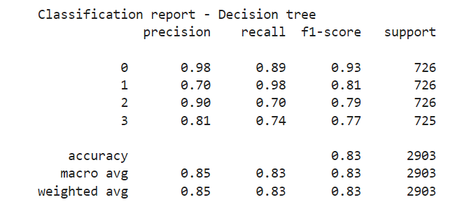
nca = NeighborhoodComponentsAnalysis(random_state=42) knn = KNeighborsClassifier(n_neighbors=4) nca_pipe = Pipeline([('nca', nca), ('knn', knn)]) nca_pipe.fit(X_train, y_train) print(nca_pipe.score(X_test, y_test))

Slide 18
Thank you for your attention

